Slide 1




EXO
SCOPE
REACHING BEYOND OUR WORLD

Slide 2

Introduction to ExoScope
WHAT IS EXOSCOPE?
ExoScope is an AI-powered web app that classifies exoplanet candidates using NASA’s TESS, K2, and Cumulative Exoplanet datasets.
It predicts whether each object is a Planet, Candidate, or False Positive, helping scientists identify new worlds faster.

Slide 3
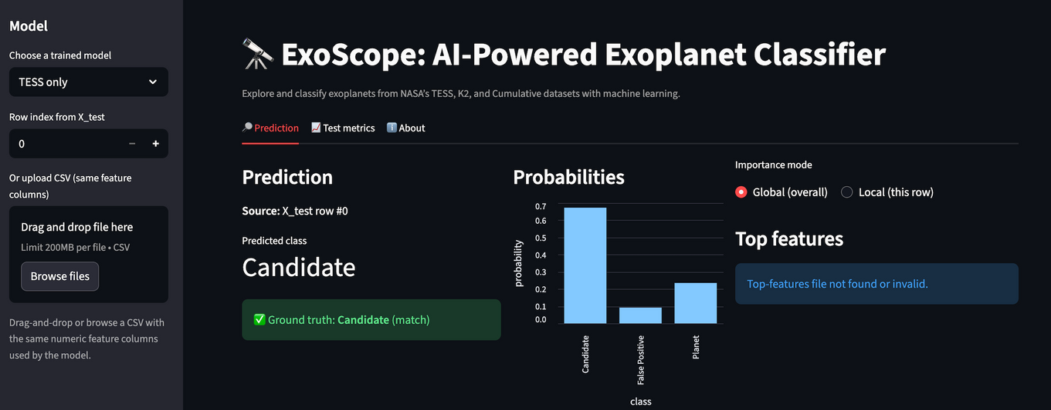
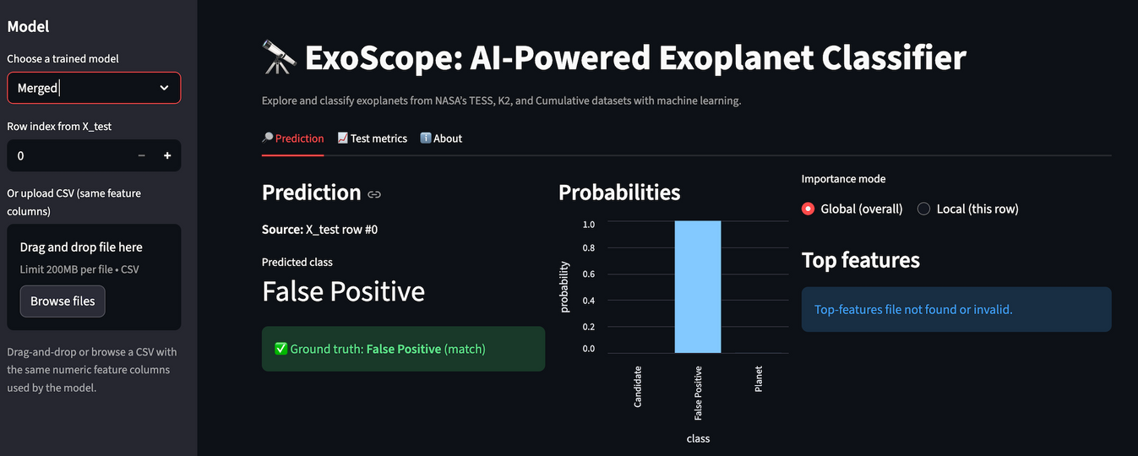
Why we should use ExoScope?
EXPAND SCIENTIFIC KNOWLEDGE
Every day, NASA’s telescopes capture signals from distant stars — hints of new worlds waiting to be found.
ExoScope uses artificial intelligence to analyze this data, identifying real exoplanets faster and more reliably.
It’s more than a tool — it’s a step toward helping humanity better understand our place in the universe.

Slide 4

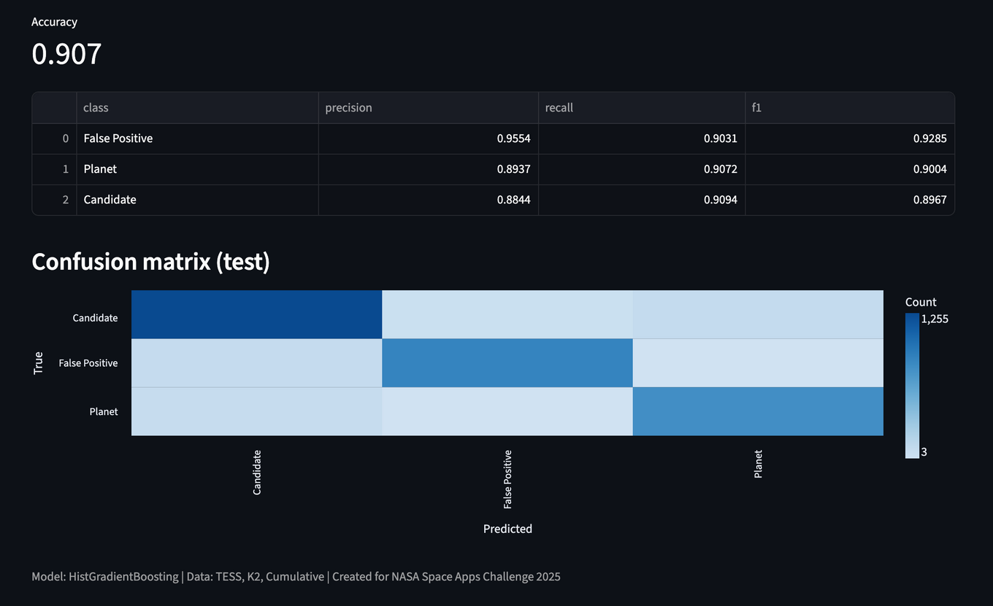
Accurate Exoplanet Detection
HIGH ACCURACY AND RELIABILITY
ExoScope reached an accuracy of 90.7%, with balanced precision and recall across all three categories.
This means our model isn’t just accurate—it’s reliable and consistent at identifying real planets versus false signals.

Slide 5

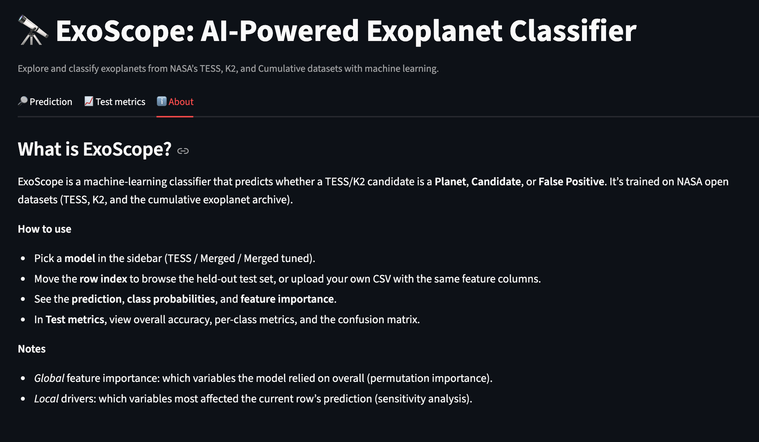
How to Use?

Slide 6

The Future Exploration
Link:
https://exoscope-vp07.onrender.com/
Advancing exoplanet research by integrating machine learning with open NASA data.

Slide 7


THANK YOU
GURBAN MUSTAFAZADE
ELIJAH KEYS
AYKHAN KHUDADANOV
AYYUB ABBASZADE

